Slide 1


Kingdom of Saudi Arabia
Ministry of Education
Prince Sattam Bin Abdulaziz University
College of Computer Engineering & Science
Dept Of Computer Science
الممــلكه العربيـــه السعـــوديه
وزارة التعليـــــم
جامــعة الأمير سطــام بن عبد العــزيز
كلية هندسة وعــلوم الحاســب
قسـم علـــوم الحاسب
No | Student Name | Student Number
1 | Abeer Mohammad Dayili
Software Engineering Project
Prepared by:
Supervised by:
Dr : Misfer Abdullah Misfer Al Dahi
Year: 2023

Slide 2
Software Engineering Project

Slide 3
Project outlines
Ii. Part One: feasibility Study & Project Proposal
A. Introduction
B. Problems
C. Background
D. Proposed Solution
E. Work Plan
Iii. Part Two :Project Requirements
A. Functional Requirements
B. Non- Functional Requirements
Iv. Part Three: Activity Diagram
V. Part Four: Use Case Modling
Vi. Part Five :Sequence Diagram
Vii. Part Six : Class Diagram

Slide 4
II. Problems The cost of transportation while going shopping from one shopping center to another Customers do not receive news or notifications about new products and offers.
I. Introduction
Online shopping is considering common these days in any country, such as buying products and clothes online, because there are a lot of benefits.

Slide 5
III. Background
"Nice One" application is one of the most famous stores sell different products online in the Kingdom of Saudi Arabia. This application was created in 2017 by Abdul Rahman and Omar Al-Olayan .
IV. Proposed Solution
It solves the difficulties that customers face in searching for the best products and buying them by converting the normal shopping of products to a method of purchasing products electronically . Also, we will provide customers with the facility of receiving real-time notifications about new offers and products.

Slide 6
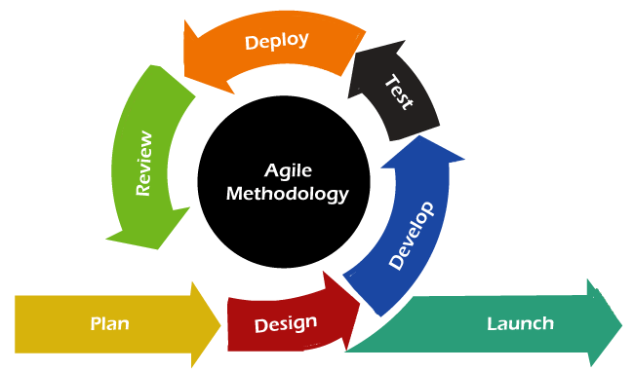
V. Work Plan
In our chosen app "Nice One," we choose agile development methodology can be beneficial.
include phases:
Planning.
Designing .
Development .
Testing .
Launch .

Slide 7
III. Part Two: Project Requirements
I. Functional Requirements (FR)
1. Customer Registration:
2. Product Display.
3. Search and Filtering.
4. Product Details.
5. Shopping Cart.
6. Notifications.
7. Order Tracking.
8. Payment Integration.

Slide 8
II. Non-Functional Requirements (NFR)
1. Performance.
2. Security.
3. Availability.
4. Usability.

Slide 9
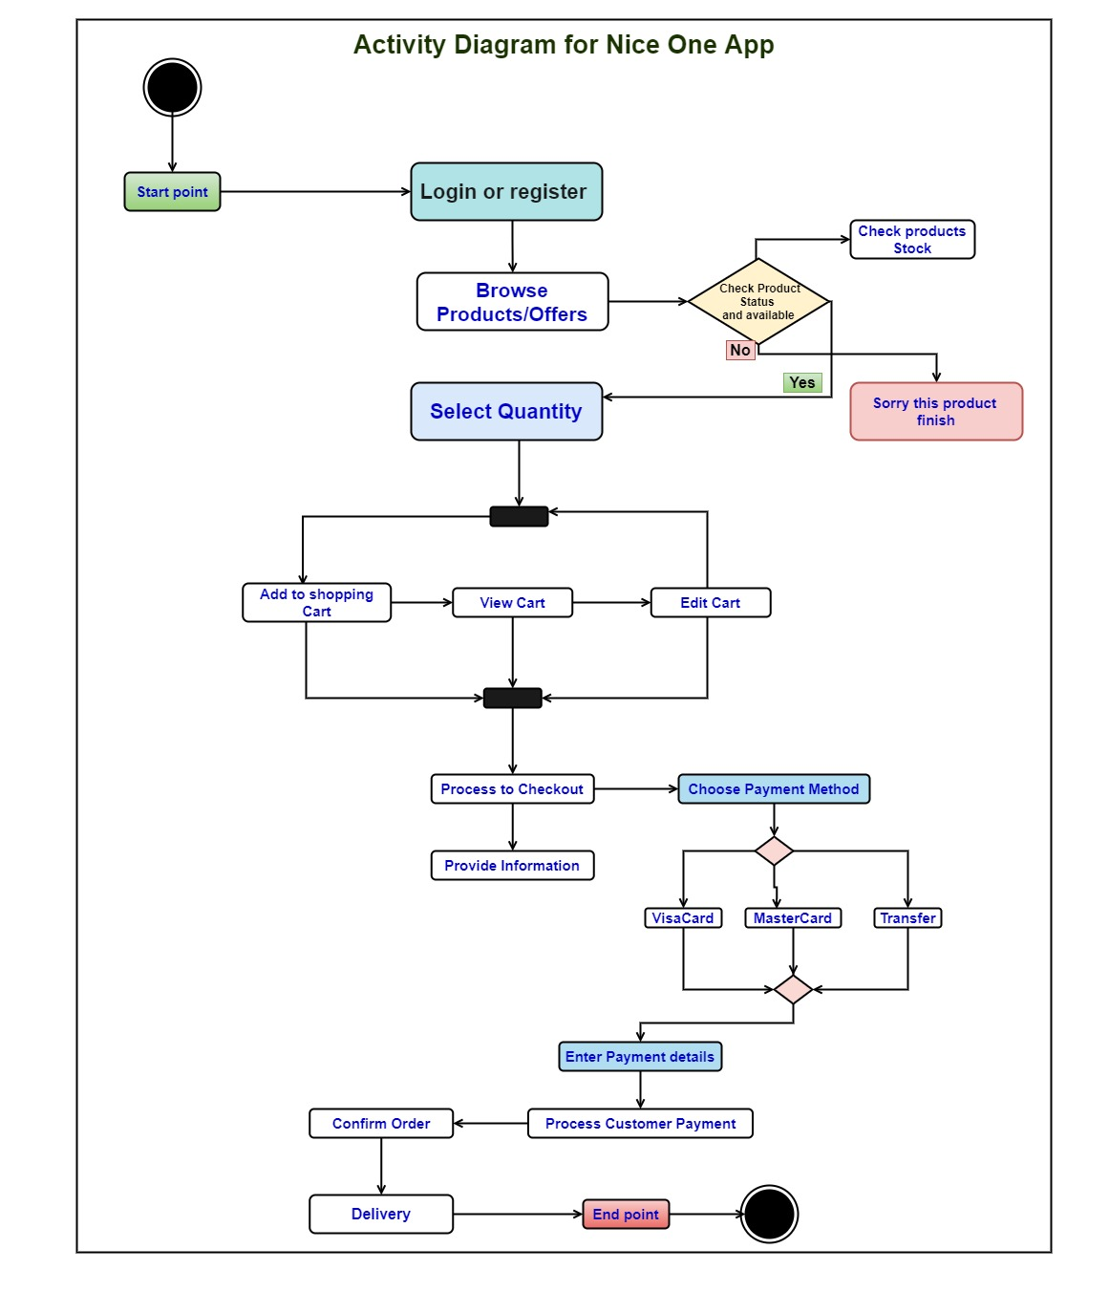
It starts with the user logging in or registering, then checking products or offers. If the user finds a product they want, they can browse by category or product, and then check the product status and availability.
If the product is in stock, the user can select a quantity and add it to their shopping cart. They can then view their cart and make any necessary edits.
Once they are ready to checkout, they can choose a payment method and provide their information. Finally, they can confirm their order and the app will process their payment.

Slide 10
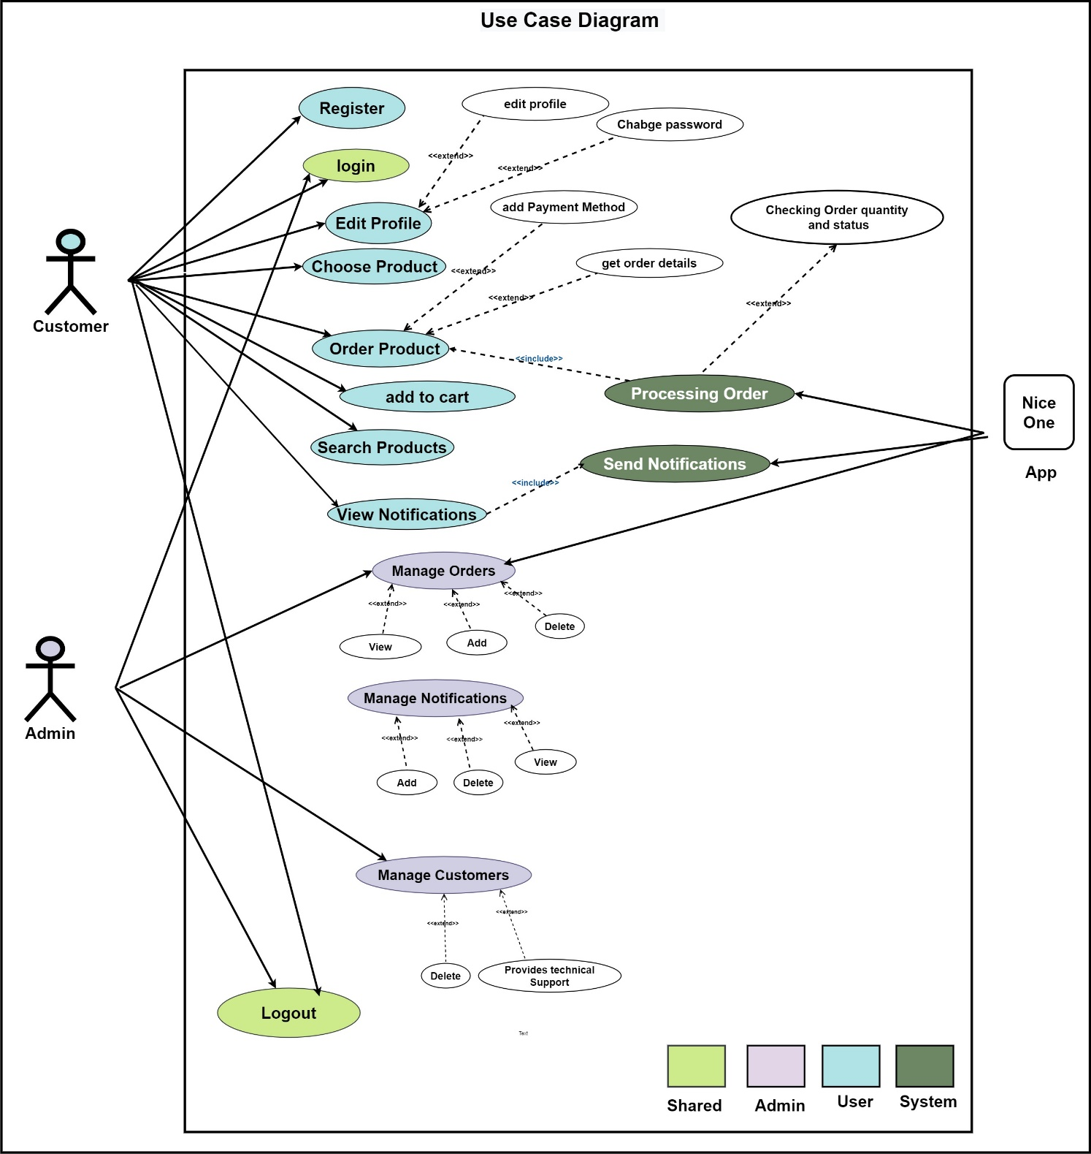
The Customer actor can perform the following use cases:
Register, Login, Edit Profile, Add Payment Method, Checking Order quantity and status, Choose Product, Get Order Details, Order Product, Search Products, View Notifications, and Manage Orders.
The Admin actor can perform the following use cases:
View, Add, and Delete Customers, Manage Orders, View and Add Notifications, and Provide technical support.

Slide 11
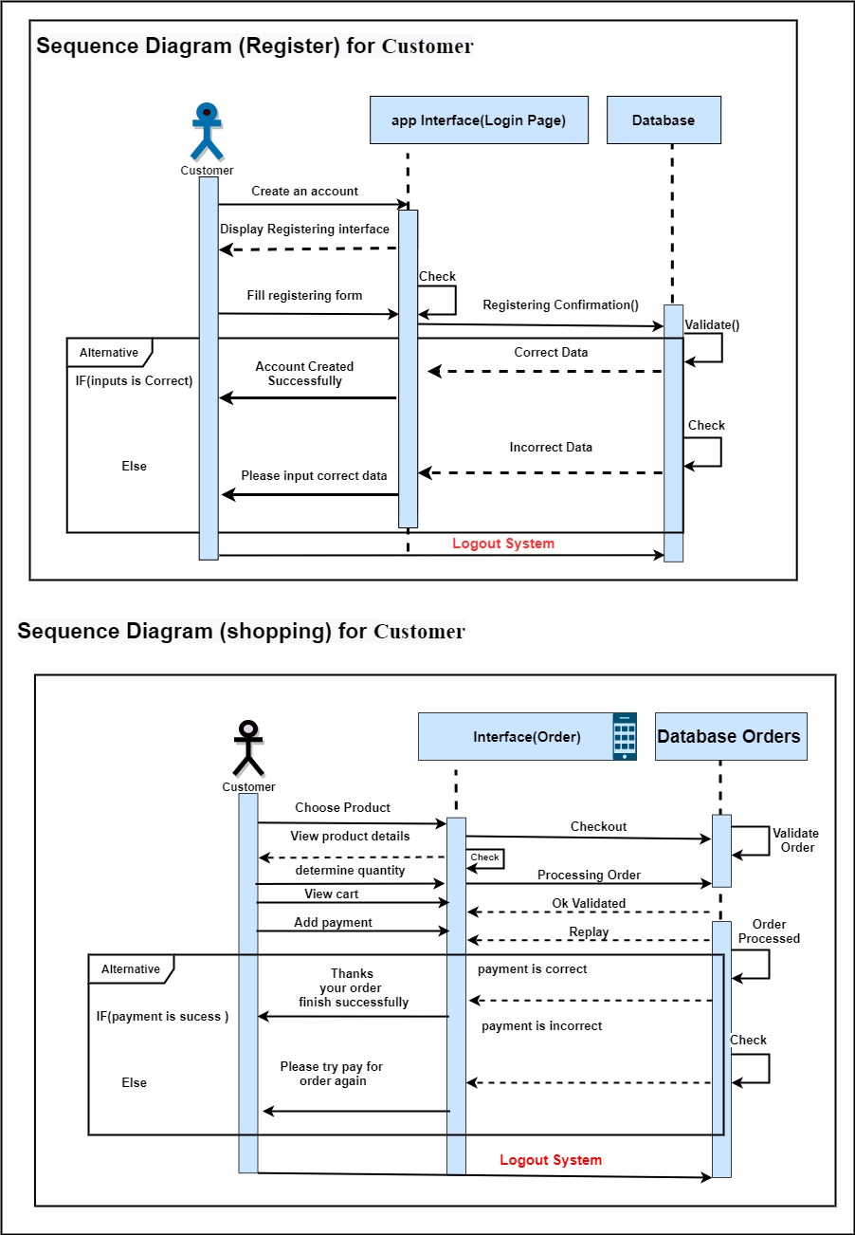
The actor user :
logging in or registering
-checking products or offers.
-browse product.
-check the product status and availability.
The actor Admin :
logging in to app
-Mange Users
-Mange Orders
-Mange Notifications

Slide 12
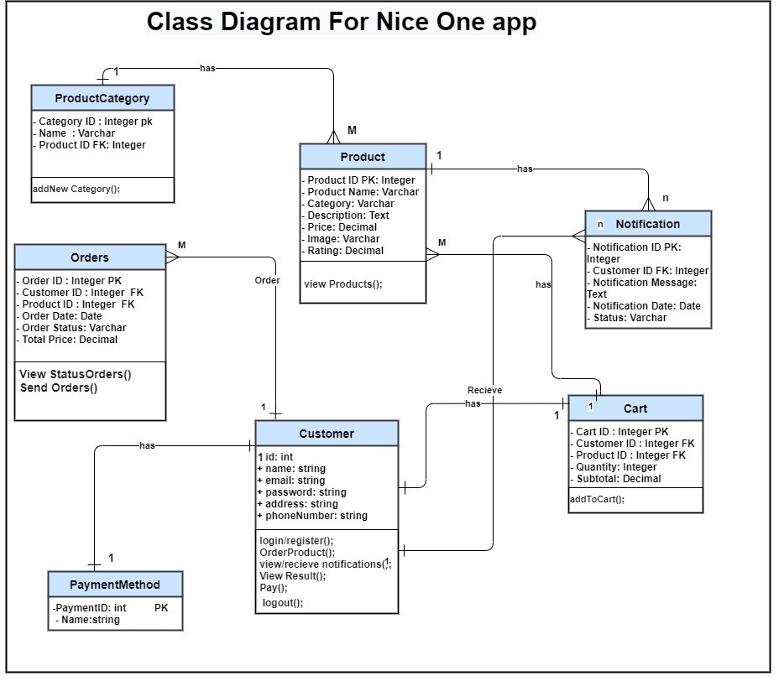
Customers:
Relations: Customers have a one-to-many relationship with Orders.
Orders :
Relations: Orders have a many-to-one relationship with Customers
Cart:
Relations: Cart has a many-to-one relationship with Customers
Notifications:
Relations: Notifications have a many-to-one relationship with Customers
Payment Methods:
Relations: Payment Methods have a many-to-one relationship with Customers .

